Slide 1
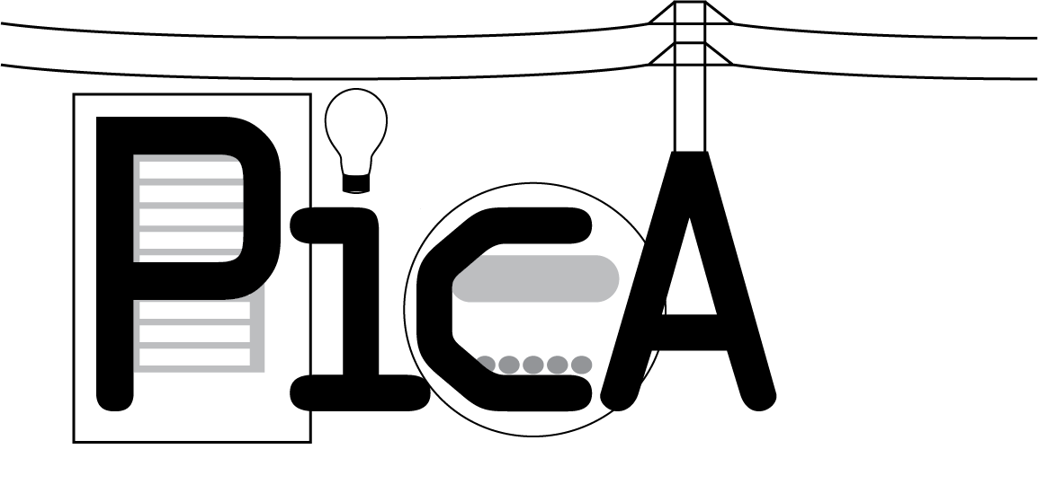

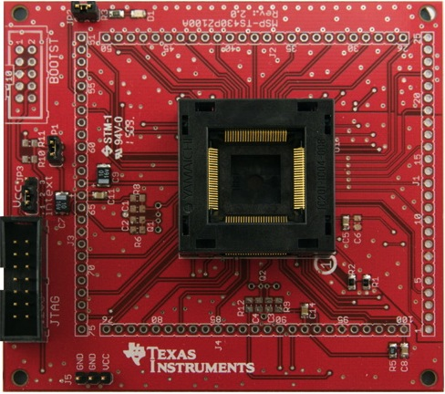
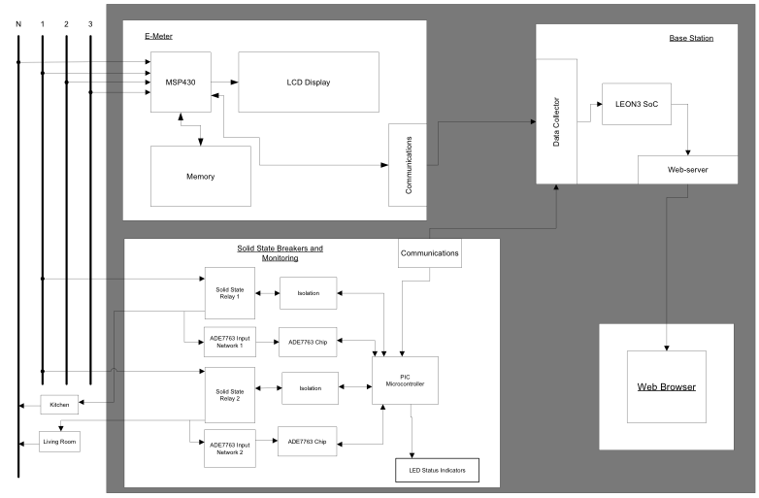
Overview:
Standard electric meters were developed decades ago and are still used today, despite many technological advances in the last several years. Along with these technological advances, Americans have become accustomed to having access to large amounts of data, but due to the nature of the standard electric meter, data regarding the usage of power is severely limited. For the power companies, data from the meters is minimal and grid control is limited to manual operation, costing them time and money.
As the cost of electricity becomes higher and higher, electricity use in buildings is becoming a bigger concern and people have few cheap or simple ways to monitor this. Of the options available, most only address part of the whole problem, giving some information to the consumer and none to the power company or vice-versa. While there are devices such as breakers and fuses that provide electrical safety for buildings, advances in technology have made it possible to further improve safety but have not been implemented in a cost-effective way or made easily available to an average consumer, which for the purpose of this project shall be defined as a person without a mathematical or scientific education beyond high-school.
Amy Ball (EE), Kendrick Wiersma (EE), Nathan Jen (EE), Avery Sterk (EE)
The E-meter replaces the conventional electromechanical meter found outside every building. The MSP430 does the monitoring and the LCD displays instantaneous and total usage outside of the building while the ethernet communications allow the system to connect with the MCU.
The solid-state breakers and monitoring are a “smart” replacement for mechanical breakers. They protect the attached circuit from drawing too much current and provide information about power usage for the attached circuit. The solid-state breaker box in the diagram represents the actual on/off switching circuitry. SS-FPGA network is the circuit required to allow the FPGA to control the breaker. The pre-sensor network steps down the voltage and contains the physical circuitry used to measure the current. The ADE7763 is the actual chip that reads the measurements and sends the information to the FPGA. The FPGA controls the solid-state breakers using the information from the ADE7763 and communicates through the ethernet controller with the MCU.
The MCU takes the information from both the E-meter and the solid-state breaker monitors and transmits it to the base station.
The base station displays all information received from the MCU in a location convenient to the consumer. It also provides the interface for configuring and updating the rest of the system.
The Loads outside of the system each represent a circuit in the building.
System block diagram
MSP430 Development Board
Solid-State Breakers:
The solid state breakers provide the real-time circuit monitoring and control. Each breaker consists of a solid-state relay, and an ADE7763, each controlled by a microcontroller. Each breaker:
Monitors voltage and current to measure usage.
Contains a configurable setting for the trip value.
Automatically reports status (on/off/trip) and can be remotely reset.
Packages data for transmission to the base station.
E-Meter:
The E-Meter is centered around a TI MSP430F47197 MCU tailored for metrology. Its duties include:
Monitoring current for up to 3 phases.
Monitoring voltage for up to 3 phases.
Detecting tampering with the meter.
Packaging measured data for transmission to base station.
Base Station:
The Base Station is centered around a SPARC V8 LEON3 processor. Its duties include:
Gathering measurements from other PICA devices.
Analyzes the measurements for user-relevant information.
Hosts the information on an internal web server.
Provides a means to control the other PICA devices.

